Slide 1
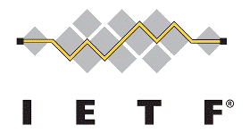
ALTO Multi-Domain
Presenter: authors
March 27, 2023
IETF 116
Notes:
https://datatracker.ietf.org/doc/draft-ietf-alto-new-transport/
https://datatracker.ietf.org/doc/draft-schott-alto-new-transport-push/

Slide 2
ALTO Re-charter (IETF 110): Multi-domain
Sebastian Kiesel (U. Stuttgart)
Ingmar Poese (Benocs) Y. Richard Yang (Yale U.)
To Confirm:
Chin Guok (esnet)
Harvey Newman (CalTech, CERN)
Feb. 21, 2021

Slide 3
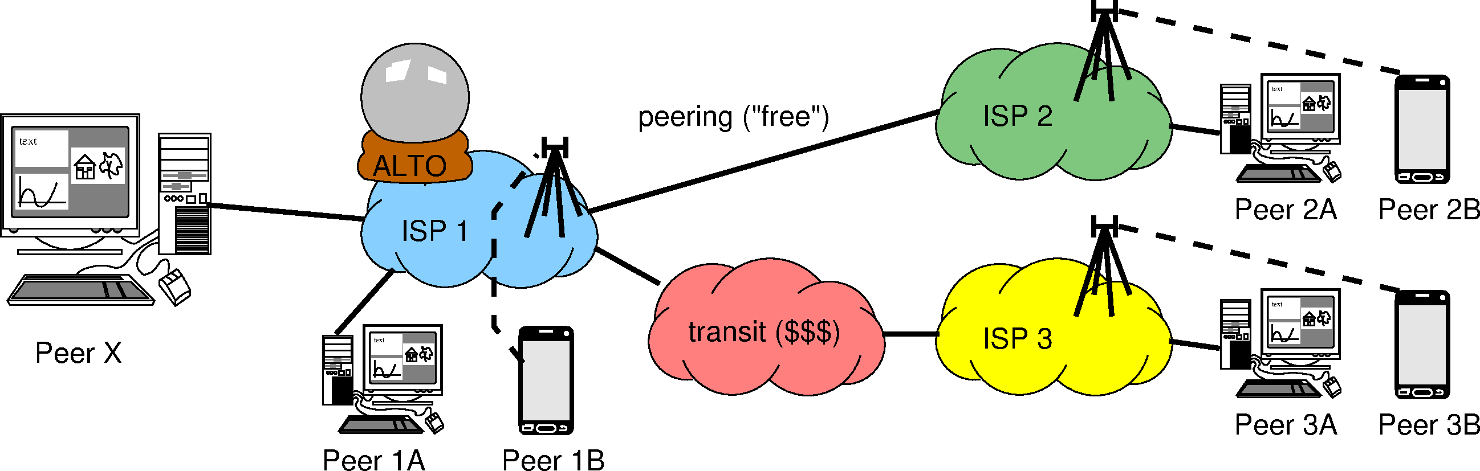

Use Case: Multi-domain Ranking (Cost Map)
Which guidance should ALTO (ISP 1) give to Peer X (based on relative preference)?
Peer 1A
Peer 1B
Peer 2A, 2B (*)
Peer 3A, 3B (*)
Peer 1A
Peer 2A, 2B (*)
Peer 1B
Peer 3A, 3B (*)
(*) = ?A and ?B are on the same level of preference, because ISP1 might not know that they are wireline vs. wireless, doesn’t care (monetary cost is the same for ISP1), and/or wouldn’t dare to tell even if they knew
Is “all within my domain” or “not in my
wireless network” more preferable?

Slide 4
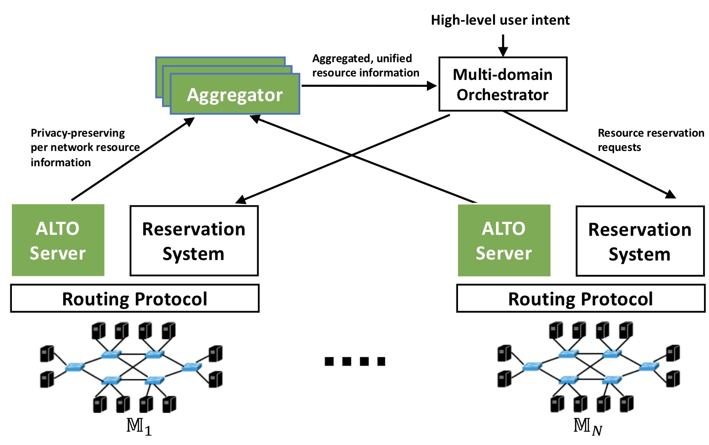
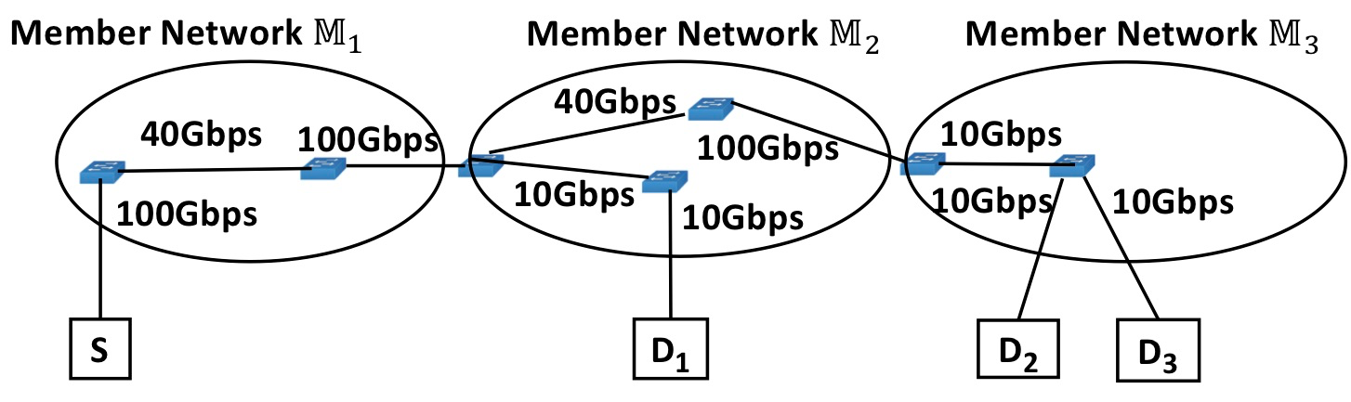
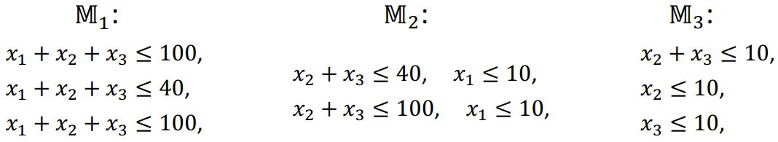
Use Case: Multi-domain Huge Data Co-Flow Resource Discovery
Large-scale data analytics (e.g., CERN LHC) span multiple networks.
Bottlenecks can come from multiple networks
Ideally, the networks collaborate but operate independently as much as possible.
Source: Xiang, et al. "Fine-grained, multi-domain network resource abstraction as a fundamental primitive to enable high-performance, collaborative data sciences." ACM/IEEE Supercomputing 2018.
Notes:
The multi-domain networking abstraction is used to solve application-layer optimizations across multiple domains.
Typically, previous uses cases ca be modeled as an optimization problem F(x, y) where the F is an objective function based on two types of variables.

Slide 5
Re-charter Text
“Extensions to ALTO services to support multi-domain settings. The current ALTO framework has made clear how to provide network information from a single ALTO server for a single network (administrative domain), but a deployment may consist of multiple domains and the potential information sources may not be limited to a certain domain. The working group will investigate extending the ALTO framework to (1) specify multi-ALTO-server protocol flow and usage guidelines when an ALTO service involves network paths spanning multiple domains with multiple ALTO servers, and (2) extend or introduce ALTO services allowing east-west interfaces for multiple ALTO server integration and collaboration. The specifications and extensions should use existing services whenever possible. The specifications and extensions should consider realistic complexities including incremental deployment, dynamicity, and security issues such as access control, authorization (e.g., an ALTO server provides information for a network that the server has no authorization), and privacy protection in multi-domain settings.”

Slide 6
Details

Slide 7
Simple Candidate Design: AMDA
Proposal starts with a simple architecture called ALTO Multi-Domain Abstractions (AMDA)
The path of a flow from a src to a dst consists of a sequence (vector) of segments from multiple networks
src -> net₁-e -> net₂-i -> … -> net_{i}-e -> net_{i+1}-i -> … -> net_{n}-e -> dst
The cost of a path is a vector corresponding to the vector of segments
The paths of a set of flows form a flow graph
Constructed by merging shared egress or ingress nodes of the segments
net1-e
net2-i
netn-e
src
dst

Slide 8
ALTO Extensions to Realize AMDA
Ext 1: Segment discovery
<flow, netid:ingress> -> <netid:egress, netid:next-ingress; [Sebastian proposal: next-alto-server-uri; handle blackhole…]>
Ext 2: Path cost discovery (extend ECS/cost map service, …)
<segment-set, metric> -> <cost/metric>
Operation models for extensions [mechanisms, not policies]
iterative (client aggregation)
recursive (network helped aggregation)
hybrid

Slide 9
Some Technical Details
A vector of path cost may no longer define a total order; define guidelines to applications on how to utilize partial ordering, and the consequences (i.e., operations considerations)
Leverage SIGCOMM’20 multi-criteria routing design
Incremental deployment: the chaining of domains may be broken due to incremental deployment (e.g., domain sequence is S -> A -> B -> C -> D, but C does not provide ALTO server)
Need to fix broken chains (e.g., proxy server based on BGP observation)
Need to discuss incentive for missing networks to deploy
To handle the prediction use case, need networks to exchange model parameters --- define an ALTO east-west interface

Slide 10
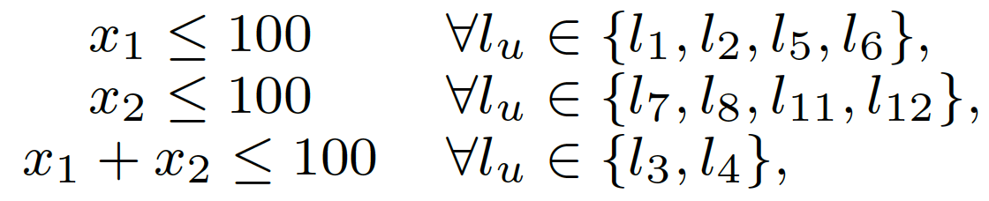
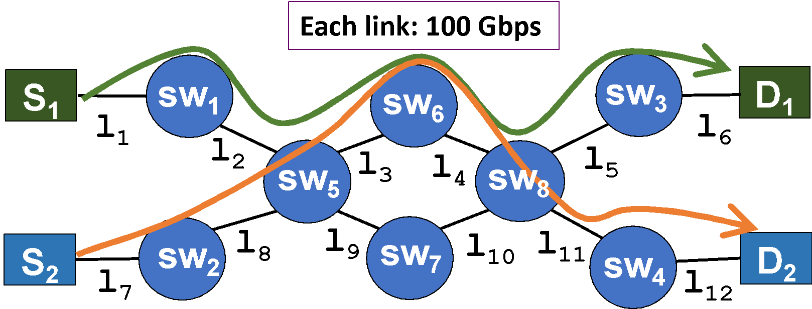
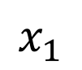
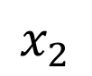
(R)PV: Mathematical Programming as Abstraction Representation
GOAL: Use mathematical programming constraints to provide a compact representation of the available bandwidth of flows through a network.
100
100
Redundant inequalities can be removed via a polynomial-time, optimal algorithm.
Remaining bottlenecks represented as abstract network elements (ANE).
Notes:
Our idea: on-demand, partianl-instantiation

Slide 11
The Reverse View: Mathematical Constraints as Virtual Network Representation
Aggregate the abstraction in multiple networks into a unified, single, virtual representation:

Slide 12
Outline
Review and recap
Main design summary
Document status
Remaining issues

Slide 13
Remaining Steps
Good to do
Discuss on mailing list to seek feedback on load balancing and protocol connection complexity
Discuss on mailing list on persistent state vs ephemeral state
Will proceed in 1 week
Small
How to read meta data (directory)
/uq return directory
/uq/meta return directory

Slide 14
Backup Slides

Slide 15
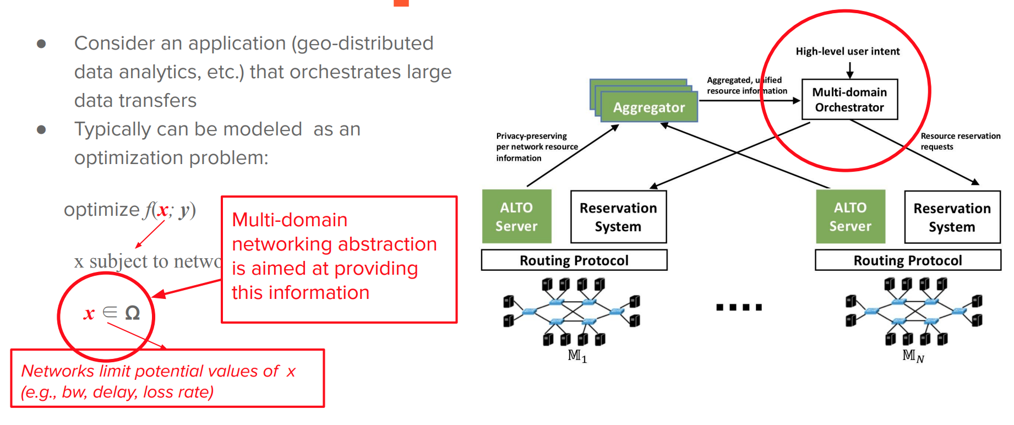
Multi-Domain Data Management Optimization
https://irtf.org/anrw/2019/slides-anrw19-final28.pdf

Slide 16
ALTO Re-charter Item: Multidomain ALTO
IETF 109, Virtual (Bangkok) Event
Nov. 19, 2020

Slide 17
Problem (Relevance)
RFC 7971: "The ALTO protocol is designed for use cases where the ALTO server and client can be located in different organizations or trust domains. ALTO is inherently designed for use in multi-domain environments. Most importantly, ALTO is designed to enable deployments in which the ALTO server and the ALTO client are not located within the same administrative domain. ”
But existing core ALTO services including Endpoint Cost Service (ECS) and Cost Map Service query a single ALTO server for the ALTO properties (e.g., routing cost, latency, …) of the whole network path, but the path may span multiple networks served by multiple ALTO servers.
Multiple projects (e.g., [1][2]) identify systematic multi-domain design as a key missing feature of ALTO.
[1] https://datatracker.ietf.org/doc/draft-lachos-alto-multi-domain-use-cases/ [2] https://datatracker.ietf.org/doc/draft-xiang-alto-multidomain-analytics/

Slide 18
Problem (Relevance)
Which guidance should ISP 1 give to Peer X (based on relative preference)?
Peer 1A
Peer 1B
Peer 2A, 2B (*)
Peer 3A, 3B (*)
Peer 1A
Peer 2A, 2B (*)
Peer 1B
Peer 3A, 3B (*)
(*) = ?A and ?B are on the same level of preference, because ISP1 might not know that they are wireline vs. wireless, doesn’t care (monetary cost is the same for ISP1), and/or wouldn’t dare to tell even if they knew
Is “all within my domain” or “not in my
wireless network” more preferable?
Sebastian Kiesel presentation on Sept. 30, 2020
ALTO
2020-09-30 ietf-alto@skiesel.de

Slide 19
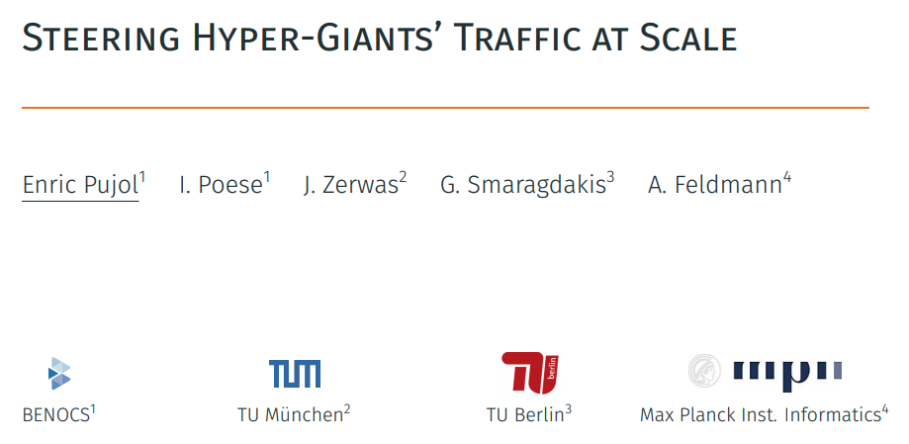
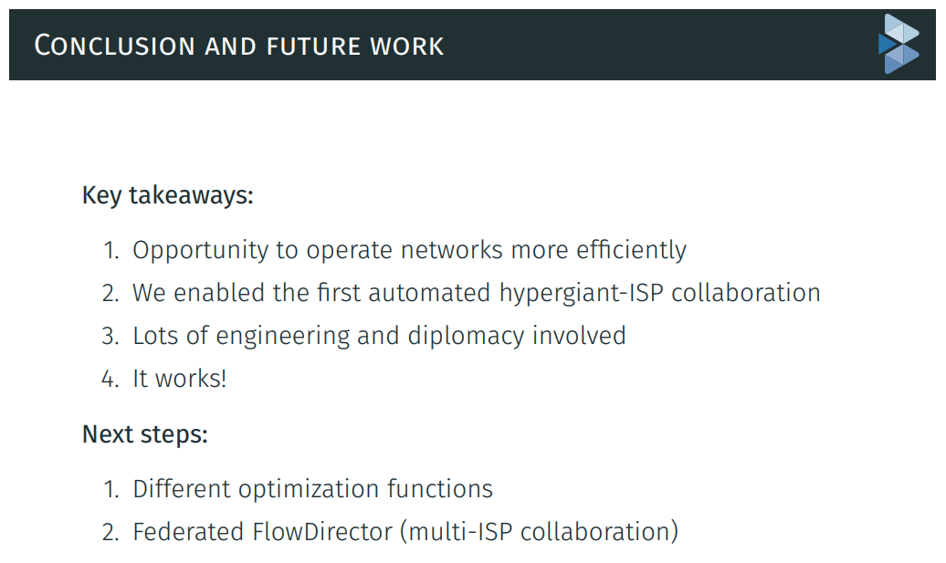
Problem (Relevance)

Slide 20
A Potential Solution (Feasibility)
WG discussed at least one reasonably well-understood, feasible architecture called ALTO Multi-Domain Abstractions (MDA)
The path of a flow from a src to a dst consists of a sequence (vector) of segments from multiple networks
src -> net₁-e -> net₂-i -> … -> net_{i}-e -> net_{i+1}-i -> … -> net_{n}-e -> dst
The cost of a path is a vector corresponding to the vector of segments
The paths of a set of flows form a flow graph
Constructed by merging shared egress or ingress nodes of the segments
net₁-e
net₂-i
net_{n}-e
src
dst

Slide 21
Simple ALTO Extensions to Realize ALTO MDA
Ext 1: Segment discovery
<flow, netid:ingress> -> <netid:egress, netid:next-ingress; [Sebastian proposal: next-alto-server-uri; handle blackhole…]>
Ext 2: Path cost discovery (extend ECS/cost map service, …)
<segment-set, metric> -> <cost>
Operation models for extensions [mechanisms, not policies]
iterative (client aggregation)
recursive (network helped aggregation)
hybrid

Slide 22
Remaining (Engineering) Issues
A vector of path cost may no longer defines a total order; candidate designs MUST discuss clear guidelines to applications on how to utilize partial ordering, and the consequences (i.e., operations considerations)
Leverage SIGCOMM’20 multi-criteria routing design
Incremental deployment: the chaining of domains may be broken due to incremental deployment (e.g., domain sequence is S -> A -> B -> C -> D, but C does not provide ALTO server)
Need to fix broken chains (e.g., proxy server based on BGP observation)
Need to discuss incentive for missing networks to deploy

Slide 23
Related References on Multidomain
https://datatracker.ietf.org/doc/draft-lachos-alto-multi-domain-use-cases/
https://datatracker.ietf.org/doc/draft-lachos-sfc-multi-domain-alto/
https://datatracker.ietf.org/doc/draft-lachosrothenberg-alto-brokermdo/
https://datatracker.ietf.org/doc/draft-lachosrothenberg-alto-md-e2e-ns/
CERN use case
https://datatracker.ietf.org/doc/draft-xiang-alto-multidomain-analytics/
https://ieeexplore.ieee.org/abstract/document/8756056
https://www.sciencedirect.com/science/article/abs/pii/S0167739X18302413
Inter-ALTO communication protocol
https://datatracker.ietf.org/doc/draft-dulinski-alto-inter-alto-protocol/
ALTO network-server, server-server API
https://datatracker.ietf.org/doc/draft-medved-alto-svr-apis/

Slide 24
Details: Who Will Work on It
Y. Richard Yang, Yale U.
Sebastian Kiesel, U. Stuttgart
Kai Gao, SCU
Bojre Ohlman, Ericsson
Danny Perez, Unicamp
Ingmar Poese, Benocs
Harvey Newman, CalTech/CERN and the GNA-G DIS WG
Qiao Xiang, XMU

Slide 25
Details: Potential Milestones (1-2 years)
Now - Mar. 2021: Presentations and meetings to clarify use cases and requirements at related venues including LHC, GNA-G DIS, panrg, PRP, …
Mar. 2021 (IETF 110): Initial draft containing use cases, requirements, preliminary design (e.g., ALTO MDA)
July 2021 (IETF 111): Prototyping of ALTO MDA and test
Nov. 2021 (IETF 112): Report prototyping results, complete specification, propose WG adoption
Mar. 2022 (IETF 113): Iteration
July 2022 (IETF 114): Submit to IESG

Slide 26
Proposed Paragraph
Extensions of ALTO services to support multi-domain settings. The current ALTO framework has made clear how to provide network information from a single ALTO server for a single network (administrative domain), but the network devices traversed by a flow can be managed by multiple networks that are not in the same domain. The working group will investigate and extend the ALTO framework to (1) specify multi-ALTO-server protocol flow and usage guidelines when an ALTO service involves network paths spanning multiple domains with multiple ALTO servers, and (2) extend or introduce ALTO services allowing east-west interfaces for multiple ALTO server integration and collaboration. The specification and extensions should use existing services whenever possible. The specification and extensions should consider realistic complexities including incremental deployment, dynamicity, and security issues including access control, authorization (e.g., an ALTO server provides information for a network that the server has no authorization), and privacy protection in multi-domain settings.

Slide 27
Backup Slides

Slide 28
IETF ALTO 2008 → RFC 7285 (2014)
ALTO protocol = one-way interface from the underlying IP network to an overlay, that is untrusted from network operator’s point of view, possibly unmanaged
P2P networks (BitTorrent)
Content Delivery Networks
The overlay nodes have only one “freedom of choice”: to which other overlay nodes (IP addresses) to connect and send/request data
Decision made in the endpoint of the data transmission
Decision made at a central location (e.g. BitTorrent tracker)
Incentive: the (postulated) “win-win situation”
Overlay network gets better performance
Cost-optimization in the underlying IP network → no price increase / no throttling for end-user
Traffic engineering in own network domain
Reduced cost for peering or upstream capacity
[Sebastian 9/30/2020]

Slide 29
Additional Questions
The “routing cost” metric makes it difficult to aggregate different point of views
See also RFC 8686, Appendix C
The “ALTO advice” runs in the opposite direction of the money
will it always stop at the peering points / Tier-1 carriers?
what if the advice given by ISP1’s ALTO server impairs ISP2’s traffic engineering?
will ISP1 be legally liable? Thus, will ISP1 refuse to give details wrt. ISP2 even if they knew?
[Sebastian 9/30/2020]

Slide 30
Multi-Domain Abstractions
The path of a flow from a src to a dst consists of a sequence (vector) of segments from multiple networks
src -> net₁-e -> net₂-i -> … -> net_{i}-e -> net_{i+1}-i -> … -> net_{n}-e -> dst
Cost of a path is a vector corresponding to the vector of segments
The paths of a set of flows form a graph
Constructed by merging shared egress or ingress nodes of the segments
Issue and how to handle vector of cost
May not define a total order; Application makes the decision [TODO: general use cases to be discussed]
net₁-e
net₂-i
net_{n}-e
src
dst

Slide 31
ALTO Extension: Realize the Abstractions
Ext 1: Segment discovery
<flow, netid:ingress> -> <netid:egress, netid:next-ingress; [Sebastian proposal: next-alto-server-uri; handle blackhole…]>
Ext 2: Cost discovery
<segment-set, metric> -> <cost>
Operation models
iterative (client aggregation)
recursive (network helped aggregation)
Notes:
Q: If client can be exposed to BGP, make clear the additional benefits.
Invite Ingmar

